Slide 1
BREAST CANCER DETECTION by Team CAVA
Amulya Rao (001586084)
Abdulla Killedar (001519675)
Chintan Bhargave (001004651)
Vaishnavi Gadve (001568298)

Slide 2
PROBLEM STATEMENT
Breast cancer point of origination and Development
Most common type - Invasive Ductal Carcinoma(IDC)
Steps Involved in diagnostics –
Ultrasound, Mammogram, MRI, Biopsy
These methods take a lot of time
Time sensitive issue

Slide 3
GOAL
01
02
03
Which model?
TARGET
Why use this model?
To fast differentiate between the 2 without patient going through biopsy
Used Deep Learning Model
To easily identify Cancerous and non-cancerous cells

Slide 4
Dataset Information
We downloaded the dataset from Kaggle.com
The dataset had a lot of Images, which we needed to unzip in order to display the images as well as use them
We then started with Visualizing the number of patches per patient we used a box plot for Visualization purposes

Slide 5
Visualizations Exploratory Data Analysis

Slide 6
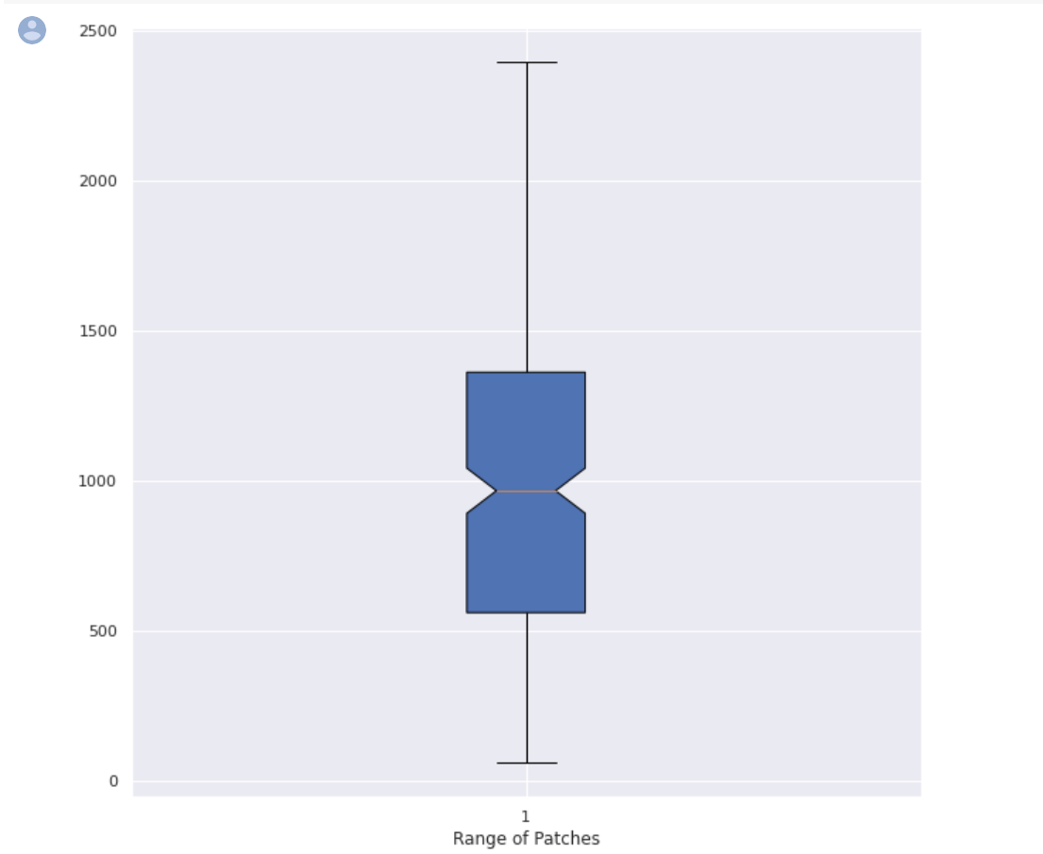
Box Plot: Range of Patches

Slide 7
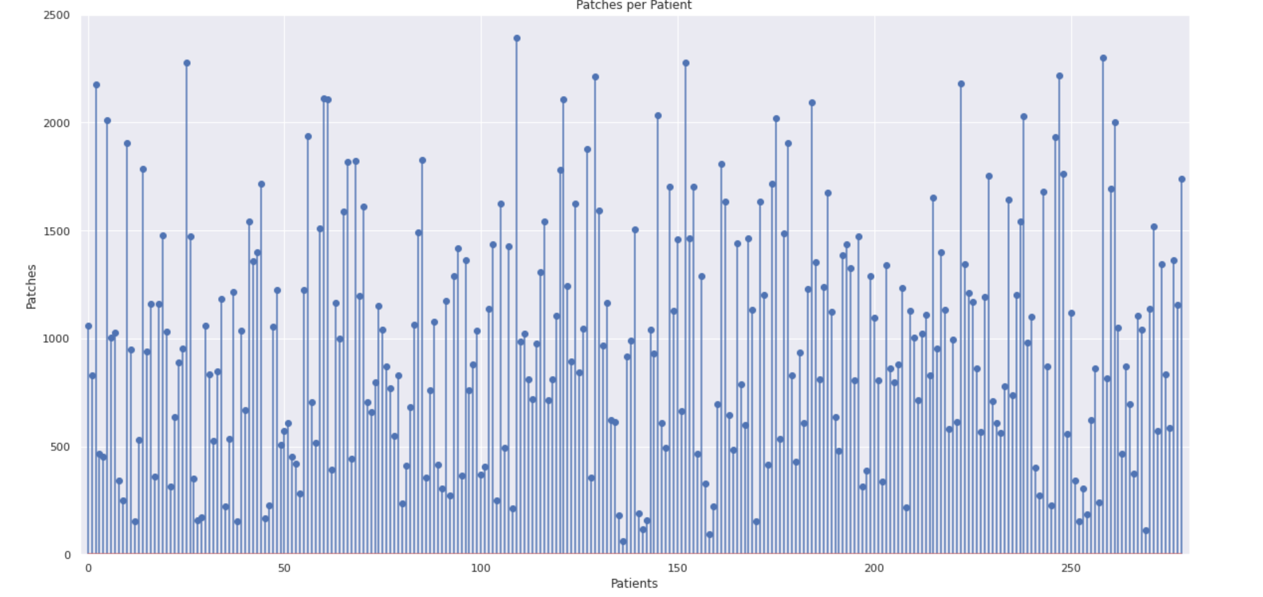
Patches Per Patient

Slide 8
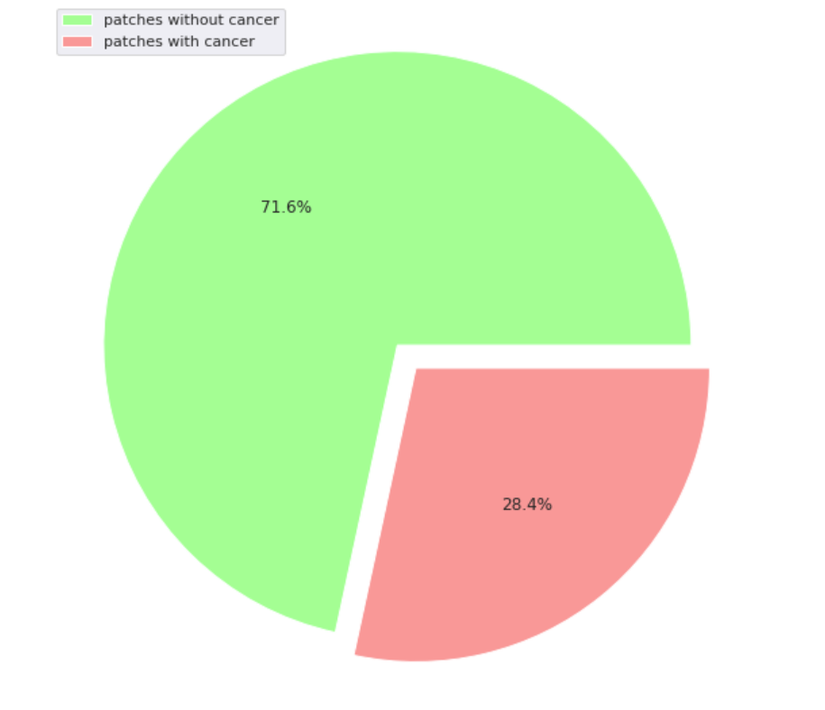
Cancerous vs Non-Cancerous Patches

Slide 9
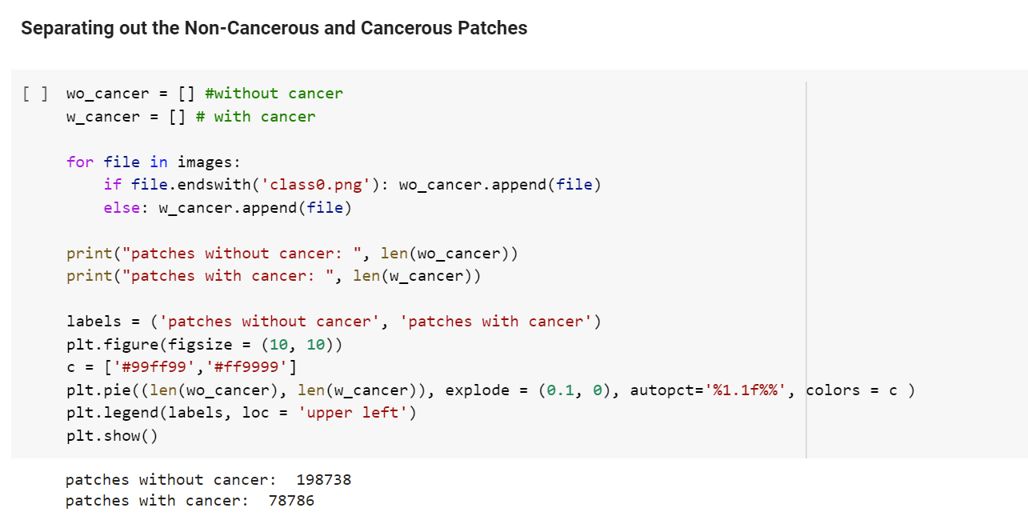
Code
We have 2 variables wo_cancer and w_cancer
These are the patches (ie. collection of cells) that are without cancer and with cancer
This code is separating out the cancerous and non-cancerous patches and displays the result in numbers
We found 198738 Patches without cancer and 78768 Patches with cancer

Slide 10
Models Used
CNN
Convolutional Neural network
ANN
Artificial Neural Network
RNN
Recurrent Neural Network

Slide 11
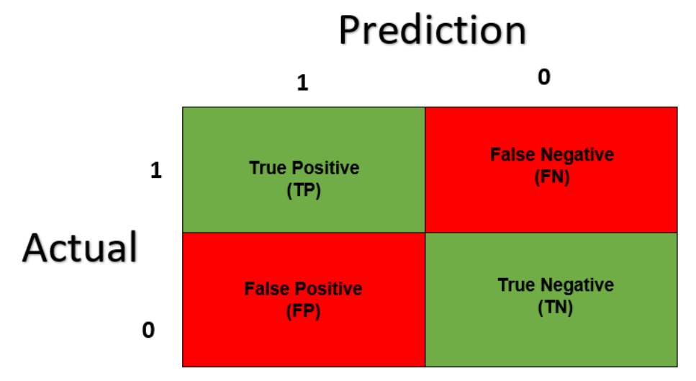
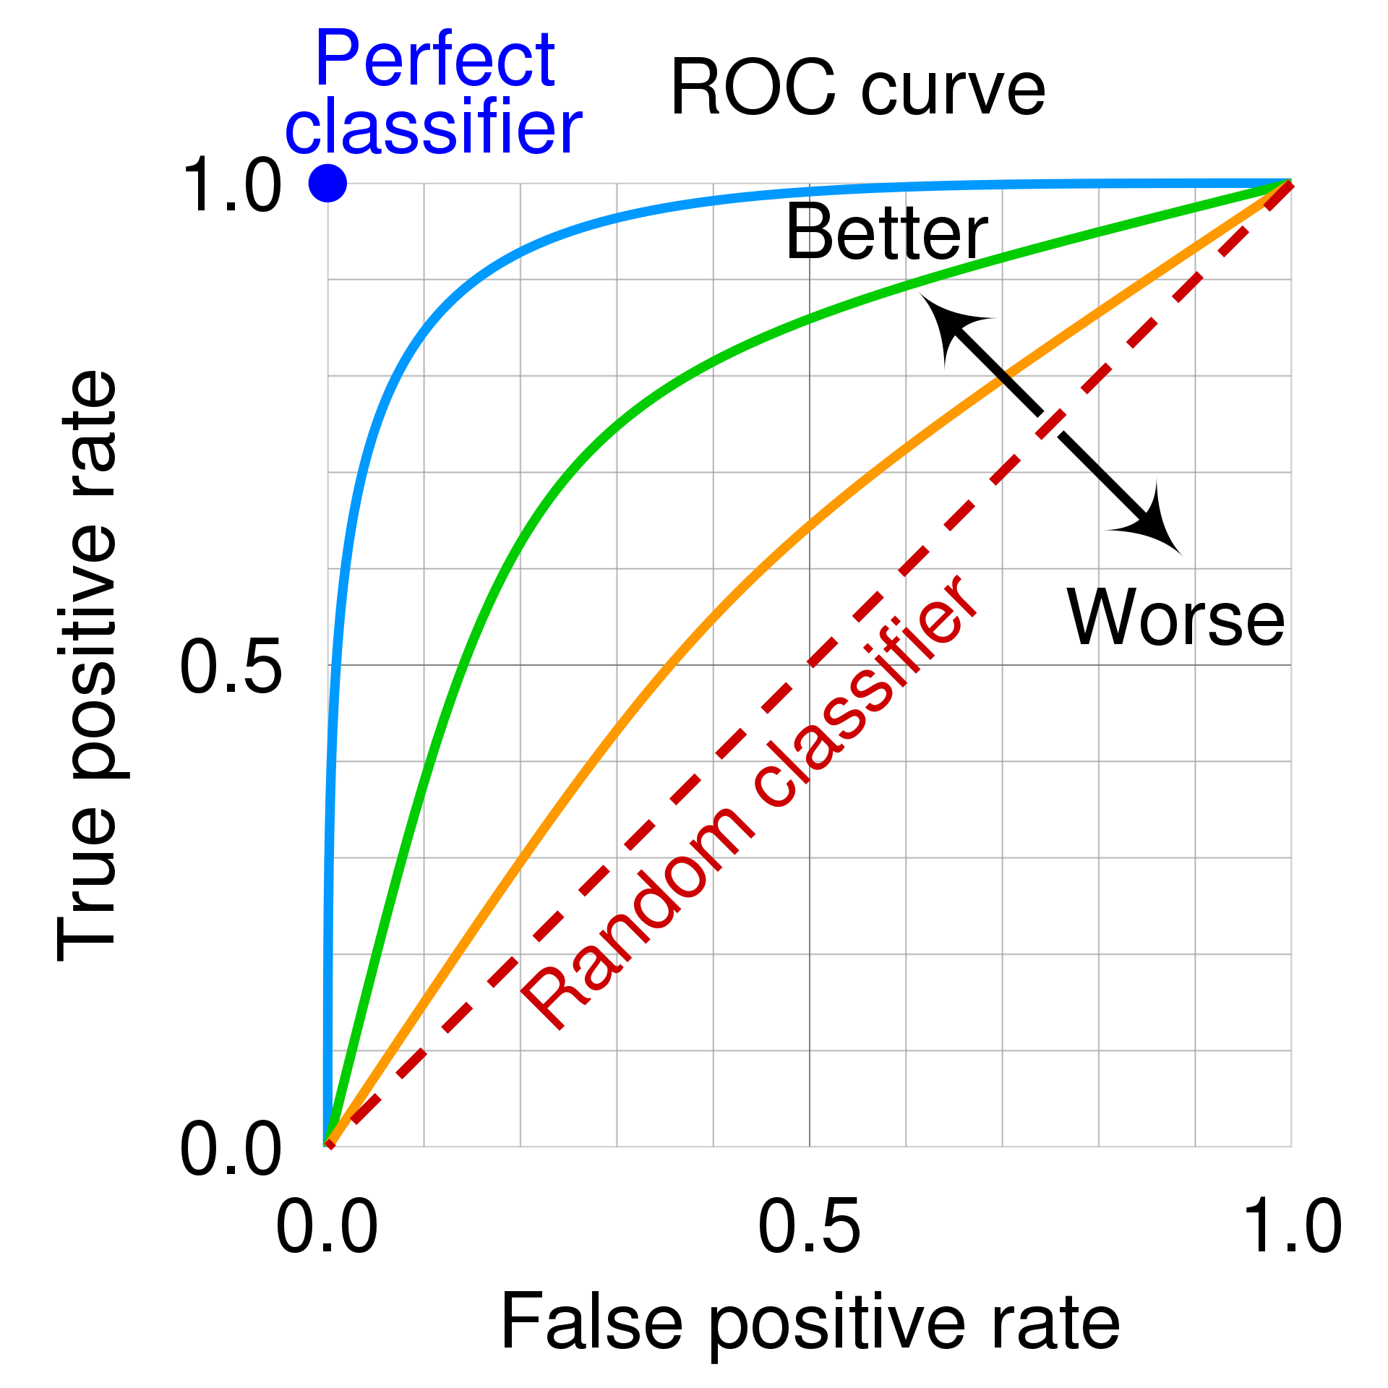
To gauge the performance of Models
Confusion Matrix
Used to compare the frequency of predicted classes to expected classes
It shows the ways in which your classification model is confused when it makes a prediction
AUC – ROC
It measures performance at a different threshold settings
AUC represents the degree or measure of separability
ROC is the probability curve

Slide 12
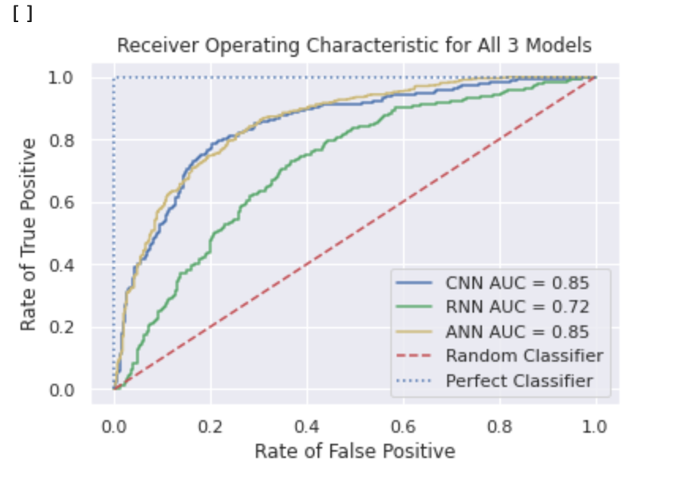
Conclusion
According to the parameters that we used for gauging the model performance we found that
ANN model is the best for Breast Cancer Prediction
AUC for CNN and ANN showed equal performance
ROC curves for both models also show a good fit
If we consider run time for both ANN requires less time to run as compared to CNN

Slide 13
Thank you!

